Slide 1
SEMROS Vendibility Results
KSU Capstone Project, Spring 2024

Slide 2
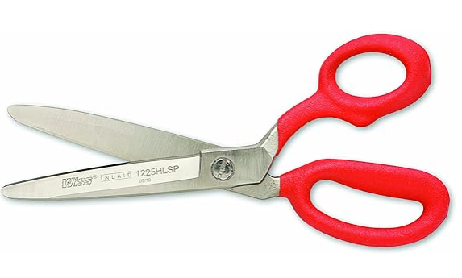
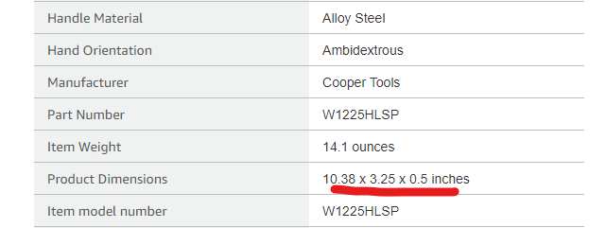
1225HLSP SCISSORS, INDUSTRIAL SHEAR
Dimensions (Proven)
05 x 3.25 x 10.38”
Dimensions (SEMROS)
05 x 3.25 x 10.38”
Results Locker Vendable: Yes Pro-lock Capacity: 6
Carousel Vendable: No Coil Vendable: No

Slide 3
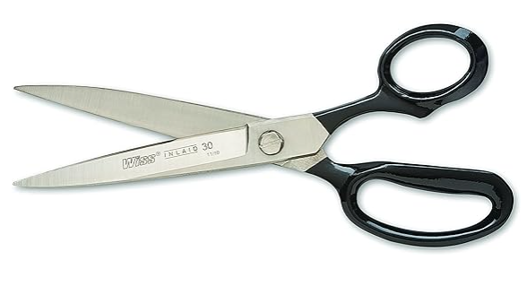
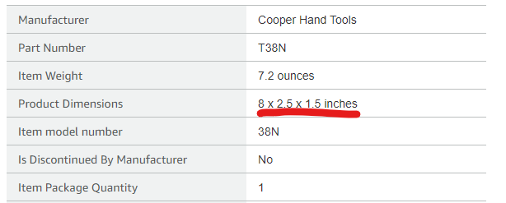
38N TRIMMERS, STRAIGHT 8-1/8IN
Dimensions (Proven)
05 x 4 x 11”
Dimensions (SEMROS)
8 x 2.5 x 1.5
Results Locker Vendable: Yes Pro-lock Capacity: 6
Carousel Vendable: Yes Number of Slots: 4 Carousel Capacity: 14
Coil Vendable: No

Slide 4
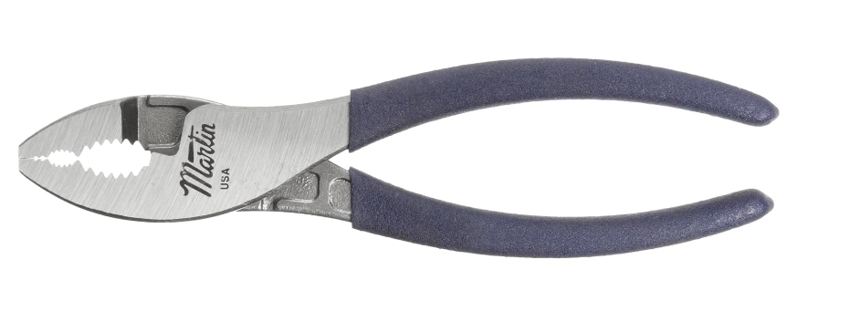
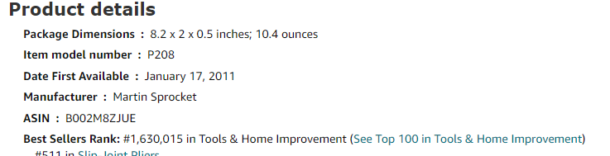
PLIER,SLIP-JOINT,8 P208, Martin Sprocket
Dimensions (Proven)
0.5 x 8.2 x 2
Dimensions (SEMROS)
0.375 x 8 x 1.344
Results Locker Vendable: Yes Pro-lock Capacity: 6
Carousel Vendable: Yes Number of Slots: 2 Carousel Capacity: 28
Coil Vendable: Yes Coil Type: Single Coil Pitch: 32

Slide 5
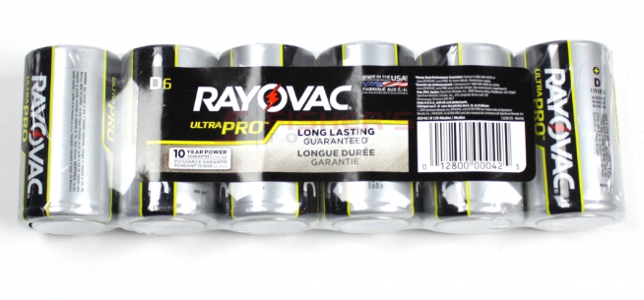
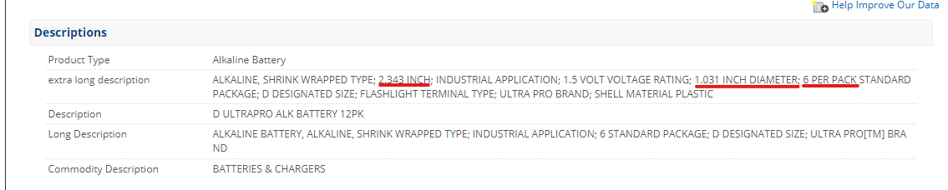
RAYOV ALD-6J ALK D INDUSTRIAL 6P
Dimensions (Proven)
1.25 x 2.38 x 7.75
Dimensions (SEMROS)
none
From https://www.elliottelectric.com/P/Item/ROV/ALD/Specifications/#tabSpecifications

Slide 6
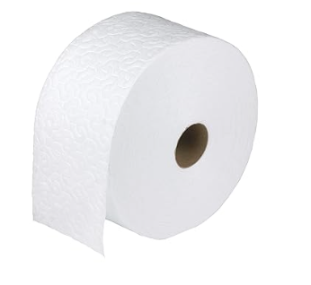
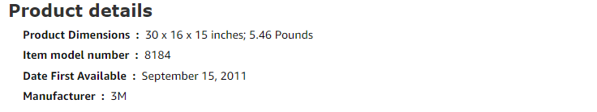
Cloth Doodleduster White7"x13.8" 250 Sht/rl
Dimensions (Proven)
9.7 x 17.3 x 17.3
Dimensions (SEMROS)
15 x 16 x 30
Results Locker Vendable: No
Carousel Vendable: No
Coil Vendable: No
From https://www.amazon.com/3M-Doodleduster-Cloth-White-Sheets/dp/B005AWYC7U

Slide 7
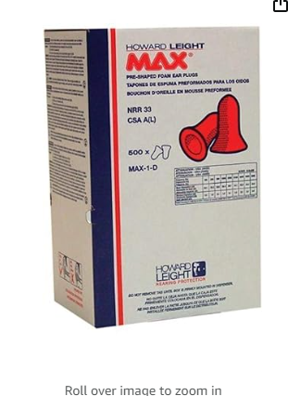
Earplug Max Nrr33 UncordCoral 500 per box
Dimensions (Proven)
11 x 7 x 4.9
Dimensions (SEMROS)
11 x 7 x 4.9
Results Locker Vendable: Yes
Carousel Vendable: No
Coil Vendable: No
Results may improve if the item description includes the capacity in “ <Count> per box” form.
From https://www.amazon.com/3M-Doodleduster-Cloth-White-Sheets/dp/B005AWYC7U

